Slide 1
Functions of Device Management
Device management involves four basic functions.
Track status of each device (such as tape drives, disk drives, printers, plotters, and terminals).
Use preset policies to determine which process will get a device and for how long.
Allocate the devices.
Deallocate the devices at 2 levels:
At process level when I/O command has been executed & device is temporarily released
At job level when job is finished & device is permanently released.

Slide 2
Types of devices
The system’s peripheral devices generally fall into one of three categories:
Dedicated
Shared
Virtual
The differences are a function of the characteristics of the devices, as well as how they’re managed by the Device Manager.

Slide 3
Dedicated Devices
Are assigned to only one job at a time.
They serve that job for the entire time the job is active or until it releases them.
Some devices demand this kind of allocation scheme, because it would be awkward to let several users share them.
Example: tape drives, printers, and plotters
Disadvantages
They must be allocated to a single user for the duration of a job’s execution, which can be quite inefficient, even though the device is not used 100% of the time.

Slide 4
Shared Devices
Can be assigned to several processes.
For example – a disk (DASD) can be shared by several processes at the same time by interleaving their requests;
This interleaving must be carefully controlled by the Device Manager.
All conflicts must be resolved based on predetermined policies.

Slide 5
Virtual Devices
A combination of the first two types.
They’re dedicated devices that have been transformed into shared devices.
Example: printer
Converted into a shareable device through a spooling program that reroutes all print requests to a disk.
Only when all of a job’s output is complete, and the printer is ready to print out the entire document, is the output sent to the printer for printing.
Because disks are shareable devices, this technique can convert one printer into several virtual printers, thus improving both its performance and use.

Slide 6
Features of Device Management
The OS interacts with the device controllers via the device drivers while allocating the device to the multiple processes executing on the system.
Device drivers can also be thought of as system software programs that bridge processes and device controllers.
The device management function's other key job is to implement the API.
Device drivers are software programs that allow an operating system to control the operation of numerous devices effectively.
The device controller used in device management operations mainly contains three registers: command, status, and data.

Slide 7
Storage Device
A storage device is any type of computing hardware that is used for storing, porting or extracting data files and objects. Storage devices can hold and store information both temporarily and permanently. They may be internal or external to a computer, server or computing device.
A storage device may also be known as a storage medium or storage media depending on whether it is seen as discrete in nature (for example, “a hard drive” versus “some hard drive space.”)

Slide 8
Computer storage is of two types:
Primary Storage Devices: It is also known as internal memory and main memory. This is a section of the CPU that holds program instructions, input data, and intermediate results. It is generally smaller in size. RAM (Random Access Memory) and ROM (Read Only Memory) are examples of primary storage.
Secondary Storage Devices: Secondary storage is a memory that is stored external to the computer. It is mainly used for the permanent and long-term storage of programs and data. Hard Disk, CD, DVD, Pen/Flash drive, SSD, etc, are examples of secondary storage.

Slide 9
Why is storage needed in a computer?
A computer would be considered a dumb terminal without a storage device. It cannot store or hold any type of information or settings if it has no storage device. Although your computer can run without storage media, you only can view or read the information on it unless it was a computer that is connected to another computer contained storage abilities. Furthermore, a storage device is needed to store information about such tasks, like browsing the Internet.
What is a storage location?
When you store any type of information on a computer or other similar devices, it may ask you to the storage location where you want to store the information. By default, there is various type of data stored on your computer hard disk. If you want to move this information to another device, you need to transfer it to another storage media, like a USB Flash Devices that makes capable you to move it to any other computer.

Slide 10
Examples of Storage Device
Magnetic Storage Device – one of the most popular types of storage used.
Floppy diskette – A normal 3 ½ inch disk can store 1.44 MB of data.
Hard drive – An internal hard drive is the main storage device in a computer. An external hard drive is also known as removable hard drive. It is used to store portable data and backups.
Magnetic strip – Magnetic tape drive stores video and audio using magnetic tape, like tape and video tape recorders.
Super disk – A disk drive and diskette that can hold 120 MB and 240 MB of data.
Cassette tape – A magnetic storage device used for audio recording and playback.
Zip diskette – Like a floppy diskette but more advanced.

Slide 11
Optical Storage Device – uses lasers and lights as its mode of saving and retrieving data.
Blu-ray disc – A digital optical storage device which was intended to replace the DVD format.
CD-ROM disc – An optical storage device that is read-only or cannot be modified nor deleted.
CD-R and CD-RW disc – CD-R is a recordable disc that can be written to once, while CD-RW is a rewritable disc that can be written to multiple times.
DVD-R, DVD+R, DVD-RW and DVD+RW disc – DVD-R and DVD+R are recordable discs that can be written to once, while DVD-RW and DVD+RW are rewritable discs that can be written to multiple times. The difference between the + and – is in the formatting and compatibility.
Flash Memory Device – is now replacing magnetic storage device as it is economical, more functional and dependable.
Memory card – An electronic flash memory device used to store digital information and commonly used in mobile electronic devices.
Memory stick – A memory card that is removable.
SSD – Solid State Drive – A flash memory device that uses integrated circuit assemblies to save data steadily.
USB flash drive, jump drive or thumb drive – A small, portable storage device connected through the USB port.

Slide 12
Online and Cloud – is now becoming widespread as people access data from different devices.
Cloud storage – Data is managed remotely and made available over a network. Basic features are free to use but upgraded version is paid monthly as a per consumption rate.
Network media – Audio, Video, Images or Text that are used on a computer network. A community of people create and use the content shared over the internet.
Paper Storage – method used by early computers for saving information.
OMR – stands for Optical Mark Recognition – A process of capturing marked data of human from forms like surveys and tests. It is used to read questionnaires with multiple choices that are shaded.
Punch card – A piece of hard paper used to contain digital information coming from the perforated holes. The presence or absence of holes in predetermined positions define the data.

Slide 13
Buffering
The buffer is an area in the main memory used to store or hold the data temporarily. In other words, buffer temporarily stores data transmitted from one place to another, either between two devices or an application. The act of storing data temporarily in the buffer is called buffering.
A buffer may be used when moving data between processes within a computer. Buffers can be implemented in a fixed memory location in hardware or by using a virtual data buffer in software, pointing at a location in the physical memory. In all cases, the data in a data buffer are stored on a physical storage medium.

Slide 14
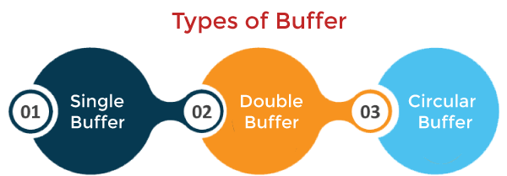
Types of Buffering
There are three main types of buffering in the operating system, such as:
Single Buffer
Double Buffer
Circular Buffer

Slide 15
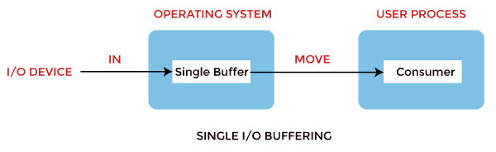
Single Buffering
In Single Buffering, only one buffer is used to transfer the data between two devices. The producer produces one block of data into the buffer. After that, the consumer consumes the buffer. Only when the buffer is empty, the processor again produces the data.

Slide 16
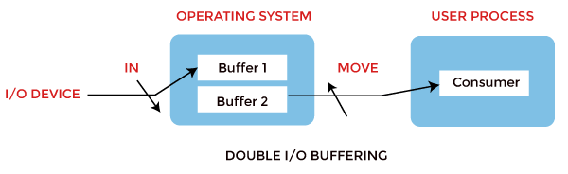
Double Buffering
In Double Buffering, two schemes or two buffers are used in the place of one. In this buffering, the producer produces one buffer while the consumer consumes another buffer simultaneously. So, the producer not needs to wait for filling the buffer. Double buffering is also known as buffer swapping.

Slide 17
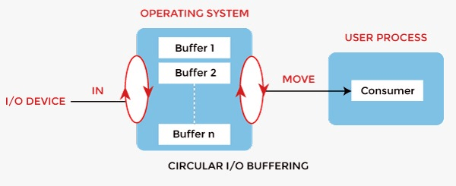
Circular buffer
When more than two buffers are used, the buffers' collection is called a circular buffer. Each buffer is being one unit in the circular buffer. The data transfer rate will increase using the circular buffer rather than the double buffering.

Slide 18
Advantages of Buffer
Buffering plays a very important role in any operating system during the execution of any process or task. It has the following advantages.
The use of buffers allows uniform disk access. It simplifies system design.
The system places no data alignment restrictions on user processes doing I/O. By copying data from user buffers to system buffers and vice versa, the kernel eliminates the need for special alignment of user buffers, making user programs simpler and more portable.
The use of the buffer can reduce the amount of disk traffic, thereby increasing overall system throughput and decreasing response time.
The buffer algorithms help ensure file system integrity.

Slide 19
Disadvantages of Buffer
Buffers are not better in all respects. Therefore, there are a few disadvantages as follows, such as:
It is costly and impractical to have the buffer be the exact size required to hold the number of elements. Thus, the buffer is slightly larger most of the time, with the rest of the space being wasted.
Buffers have a fixed size at any point in time. When the buffer is full, it must be reallocated with a larger size, and its elements must be moved. Similarly, when the number of valid elements in the buffer is significantly smaller than its size, the buffer must be reallocated with a smaller size and elements be moved to avoid too much waste.
Use of the buffer requires an extra data copy when reading and writing to and from user processes. When transmitting large amounts of data, the extra copy slows down performance.

Slide 20
Spooling
Spooling is a process in which data is temporarily held to be used and executed by a device, program, or system. Data is sent to and stored in memory or other volatile storage until the program or computer requests it for execution.
SPOOL is an acronym for simultaneous peripheral operations online.
Generally, the spool is maintained on the computer's physical memory, buffers, or the I/O device-specific interrupts. The spool is processed in ascending order, working based on a FIFO (first-in, first-out) algorithm.

Slide 21
Advantages of Spooling
The number of I/O devices or operations does not matter. Many I/O devices can work together simultaneously without any interference or disruption to each other.
In spooling, there is no interaction between the I/O devices and the CPU. That means there is no need for the CPU to wait for the I/O operations to take place. Such operations take a long time to finish executing, so the CPU will not wait for them to finish.
CPU in the idle state is not considered very efficient. Most protocols are created to utilize the CPU efficiently in the minimum amount of time. In spooling, the CPU is kept busy most of the time and only goes to the idle state when the queue is exhausted. So, all the tasks are added to the queue, and the CPU will finish all those tasks and then go into the idle state.
It allows applications to run at the speed of the CPU while operating the I/O devices at their respective full speeds.

Slide 22
Disadvantages of Spooling
Spooling requires a large amount of storage depending on the number of requests made by the input and the number of input devices connected.
Because the SPOOL is created in the secondary storage, having many input devices working simultaneously may take up a lot of space on the secondary storage and thus increase disk traffic. This results in the disk getting slower and slower as the traffic increases more and more.
Spooling is used for copying and executing data from a slower device to a faster device. The slower device creates a SPOOL to store the data to be operated upon in a queue, and the CPU works on it. This process in itself makes Spooling futile to use in real-time environments where we need real-time results from the CPU. This is because the input device is slower and thus produces its data at a slower pace while the CPU can operate faster, so it moves on to the next process in the queue. This is why the final result or output is produced at a later time instead of in real-time.

